Slide 1
Depth Map Generation
Project-No :-29
Professor: Avinash Sharma
TA: Navyasri Reddy

Slide 2
Team Members :
J.S.S Sravan Chandra - 201501025
Kamineni Vikas - 201501092
Avinash Vadlamudi - 201501164

Slide 3
Description
To estimate depth information from a single view of rgb image.
This method is based on the new view of image classification technique, which is able to classify the images into outdoor without geometric elements, outdoor with geometric elements or indoor.
This method requires less computational effort.

Slide 4
Procedure:
Color Based Segmentation
Region Detection
Image Classification
Geometric depth map Generation
Depth Map Generation by Fusion

Slide 5
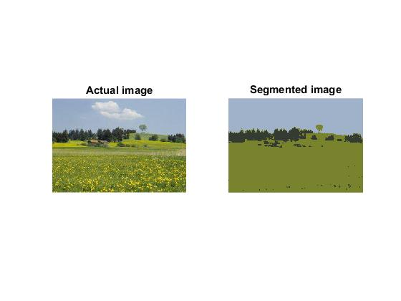
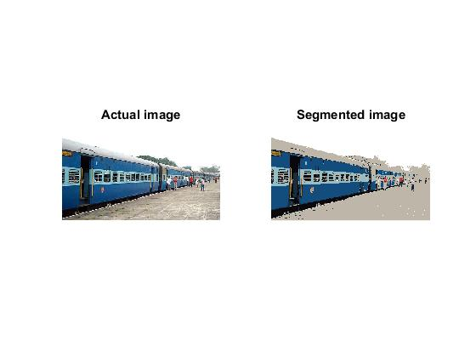
Color Based Segmentation
Here we used mean shift algorithm to segment the image based on color.

Slide 6
Region Detection:
The semantic region detection can be based on color-based rules aimed to characterize specific regions such as: Sky, Far Mountain, Near Mountain, Land and Other.
For this we need to perform the following steps:
Apply a 5X5 median filter to the segmented image
Compute HSV image from segmented image
The above specific regions are detected by following color-based rules. These rules are made by experimenting with specific set of images.(Actually, the paper has implemented these by training on a data set, which we don’t have access to)
After this , each region is assigned a specific gray value based on following order:
Gray(Other) > Gray(Land) > Gray(Near Mountain) > Gray(Far Mountain) > Gray(Sky)
5) Apply median filter again to remove the outliers in the above classified image.

Slide 7
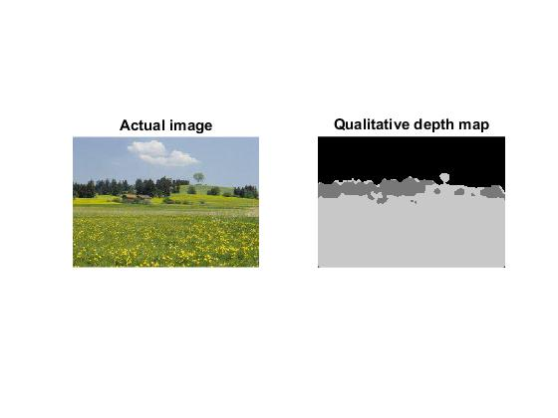
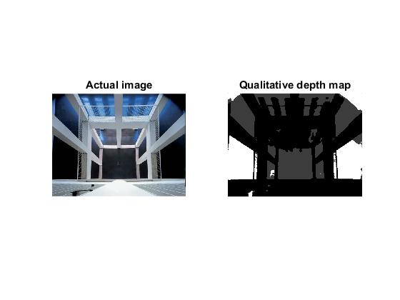
Results:

Slide 8
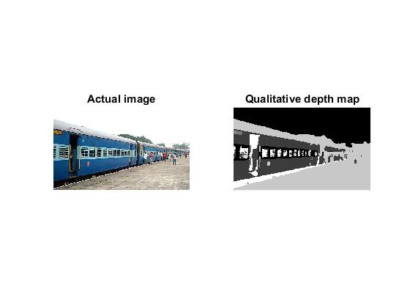
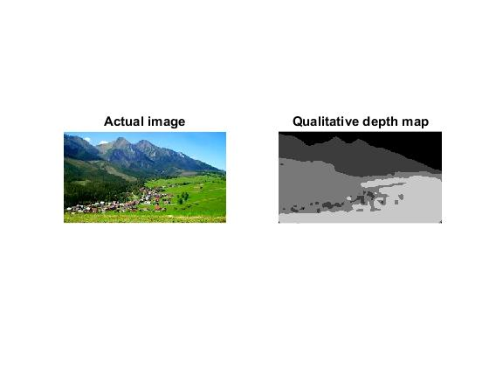

Slide 9
Image Classification:
We need to classify the image into outdoor without geometric elements, outdoor with geometric elements or indoor.
We select some column regions from the above obtained qualitative depth map
Find the number of region changes while we traverse the column from top to bottom
If the top region is sky and if the number of region changes are less than a particular threshold, we increment the count of R by 1 or else if the sky is top region we increment the count of R2 by 1
If the R value is greater than K1*N, where N is the number of analyzed column regions and K1 is a threshold in (0,1), we classify the image as outdoor without geometric elements.

Slide 10
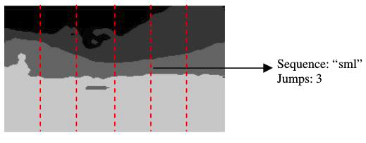
Image Classification (continued)
Otherwise, if the value of R2 is greater than K2*N, where K2 is threshold in (0,1), we classify the image as outdoor with geometric elements.
Else it is classified as indoor.
The values of K1 and K2 are obtained by experimenting on a specific set of images.

Slide 11
Results:
Classified as an outdoor image
Without geometric elements.
Classified as an outdoor image
With geometric elements.

Slide 12
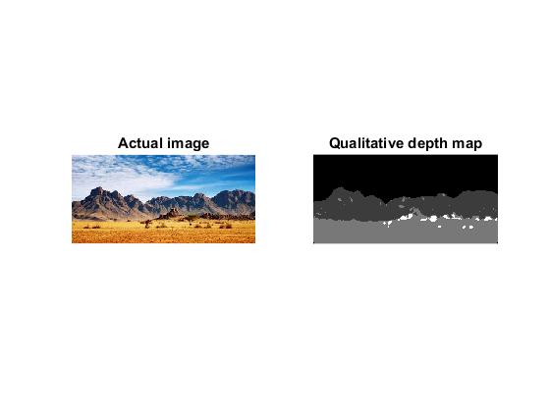
Classified as an outdoor image
Without geometric elements.
Classified as an indoor image

Slide 13
Geometric Depth Map
Vanishing point detection:
If the image is classified as outdoor without Geometric elements, vanishing point is considered as the bottom-most intersection point with mountain or sky with land or others.
Edge detection using a 3x3 Sobel masks. The resulting images, I_{Sx} and I_{Sy} , are then normalized and converted into a binary image I E, eliminating redundant information.
Noise reduction of I_{Sx} and I_{Sy} using a standard low-pass filter 5x5.
Detection of line through hough lines by keeping voting threshold.
Compute of intersection between each pair of straight lines.
The Vanishing Point is chosen as the intersection point with the greatest number of intersections around it, while the vanishing lines detected are the main straight lines passing close to Vanishing Point.

Slide 14
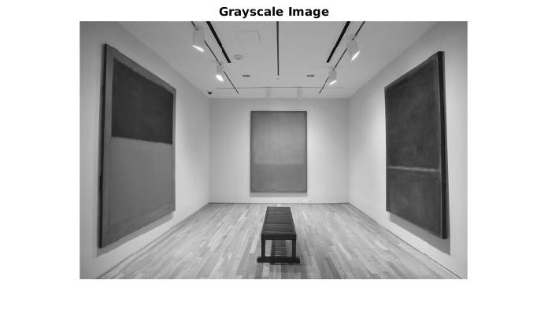
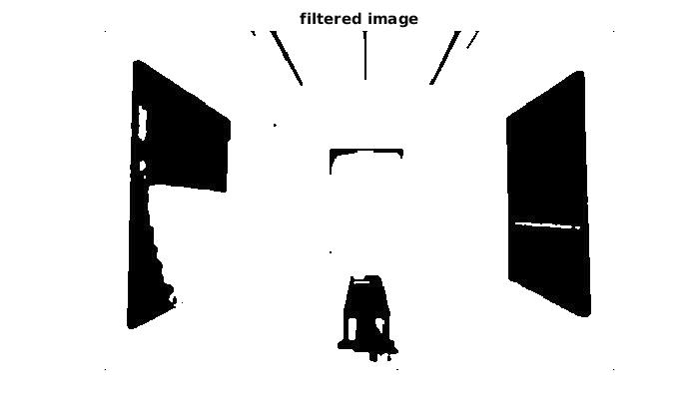
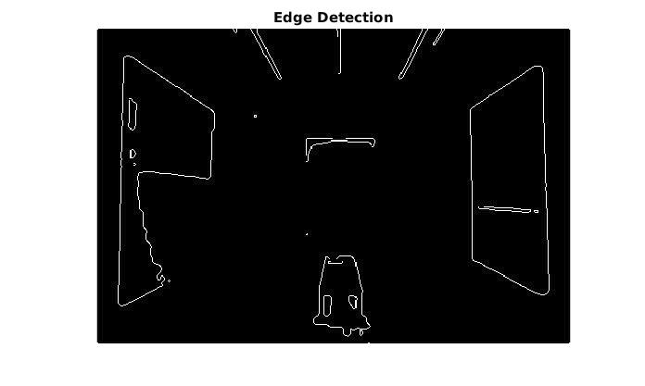
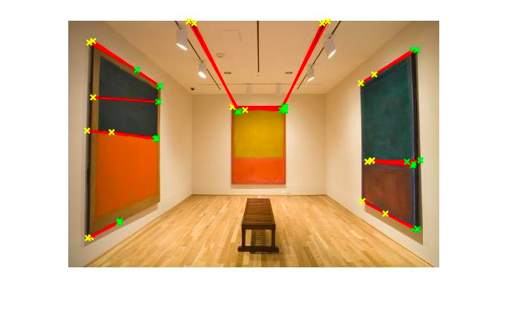
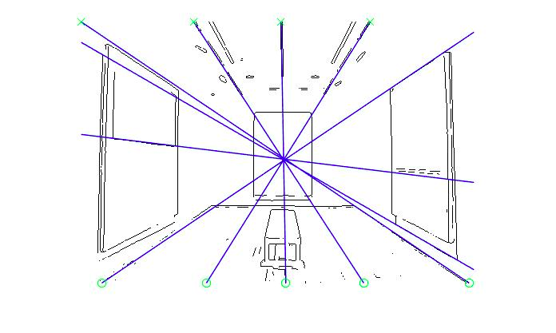
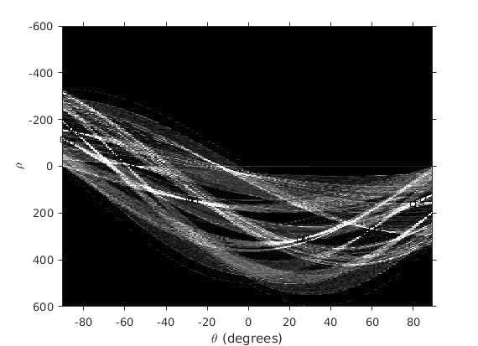

Slide 15
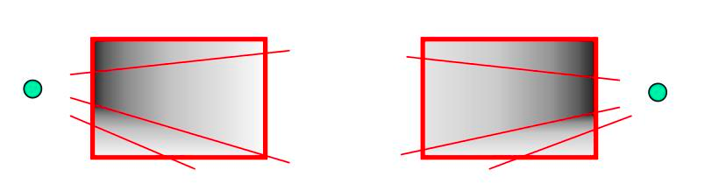
Gradient Plane generation and Depth gradient Assignment:

Slide 16
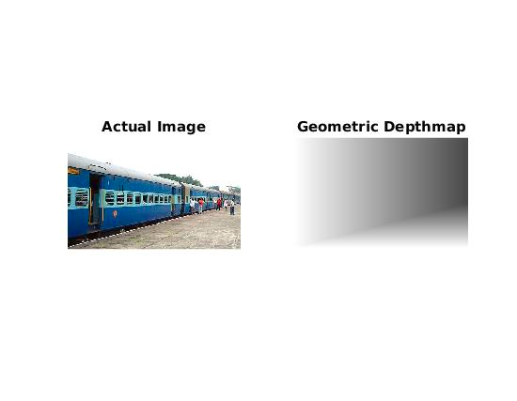
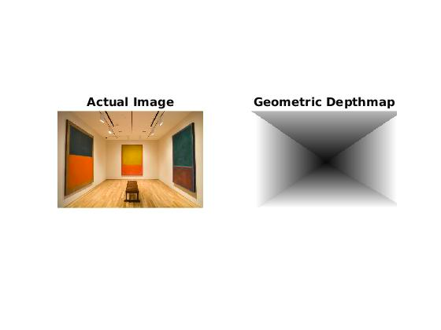
Results:

Slide 17
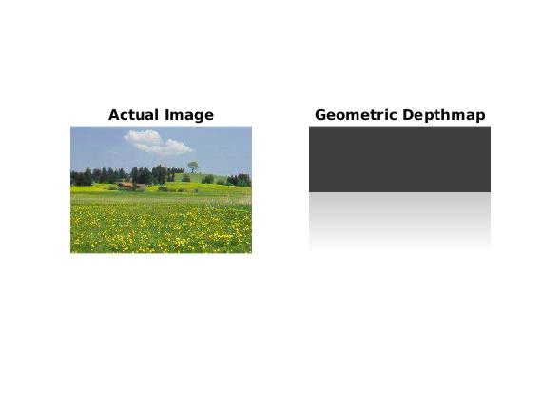
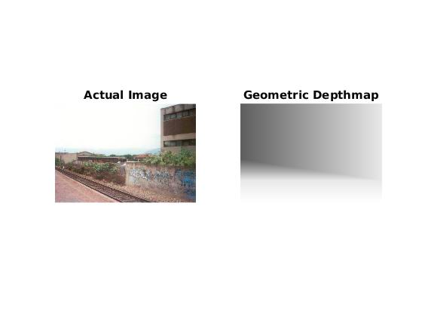

Slide 18
Fusion of Geometric and Qualitative Depth Maps:
The Fusion depends on the image classification:
If the image belongs to the indoor category then M(x,y) coincides with M1(x,y):
M(x,y) = M1(x,y) ∀(x,y) : 0<=x<=W-1 0<=y<=H-1.
If the image is classified as Outdoor with absence of meaningful geometric components (landscape) then the image M(x,y) is obtained as follows:
M(x,y) = M1(x,y)∀(x,y)∈Land and ∀(x,y) ∈ Other
M(x,y) = M2(x,y) ∀(x,y)∉Land and ∀(x,y) ∉ Other
If the image is classified as Outdoor with geometric characteristics then the image M(x,y) is obtained as follows:
M(x,y) = M2(x,y) ∀(x,y) ∈Sky.
M(x,y) = M1(x,y) ∀(x,y) ∉Sky.
Where M1(x,y) is Geometric DepthMap and M2(x,y) is Qualitative DepthMap

Slide 19
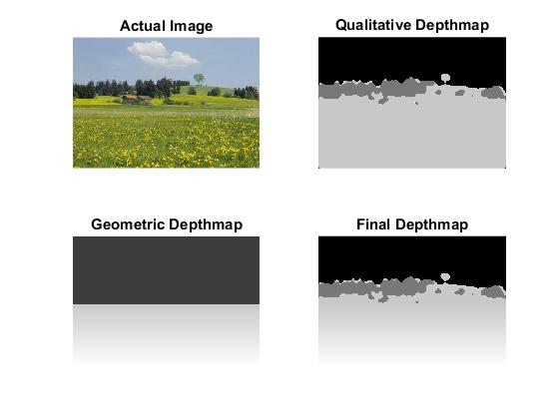
Final Results:

Slide 20
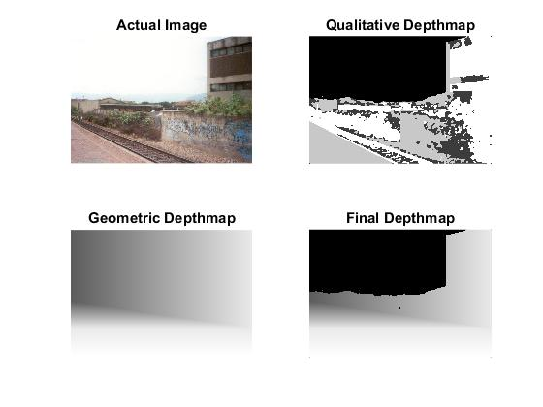

Slide 21
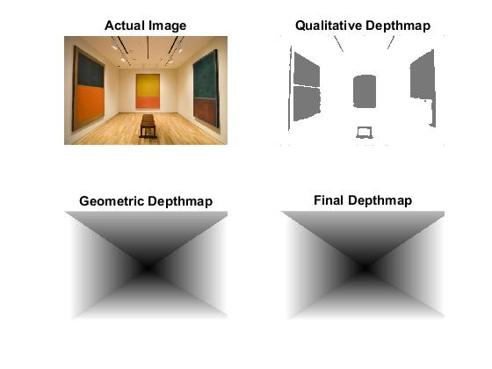

Slide 22
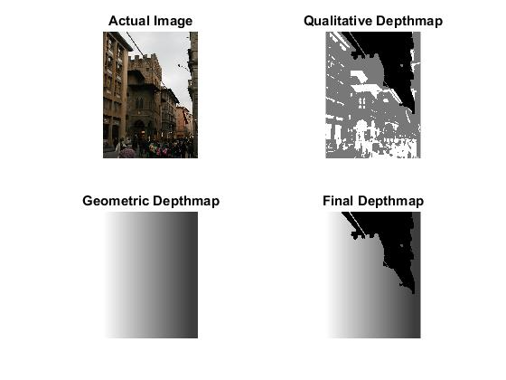

Slide 23
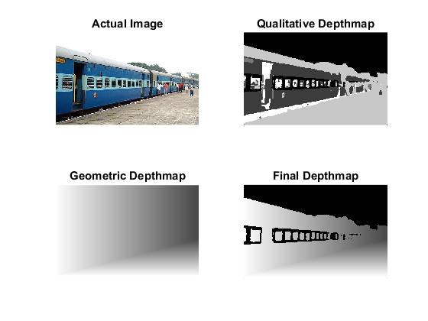

Slide 24
Limitations:
We don’t have the training dataset so we cannot get the appropriate color values which can classify all the regions correctly for all types of images and Geometric Depth map heuristics.
Similarly we cannot get the appropriate k1 and k2 values which could classify the image correctly for any image.
If there are more than one vanishing point, our method doesn’t work, i.e., finding the geometric depth map doesn’t work.

Slide 25
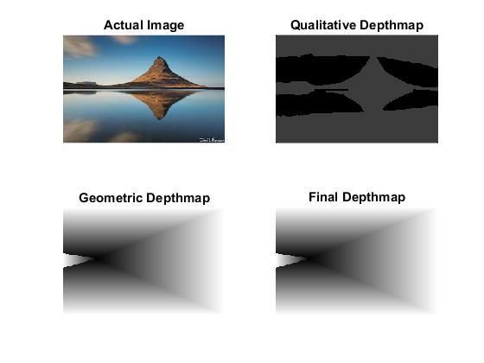

Slide 26
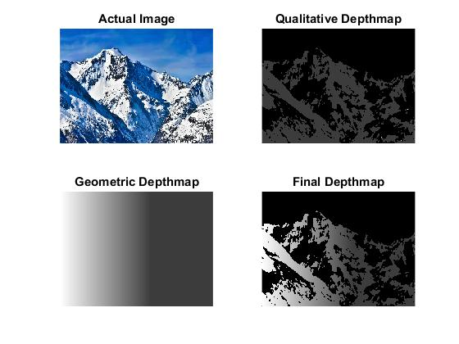

Slide 27
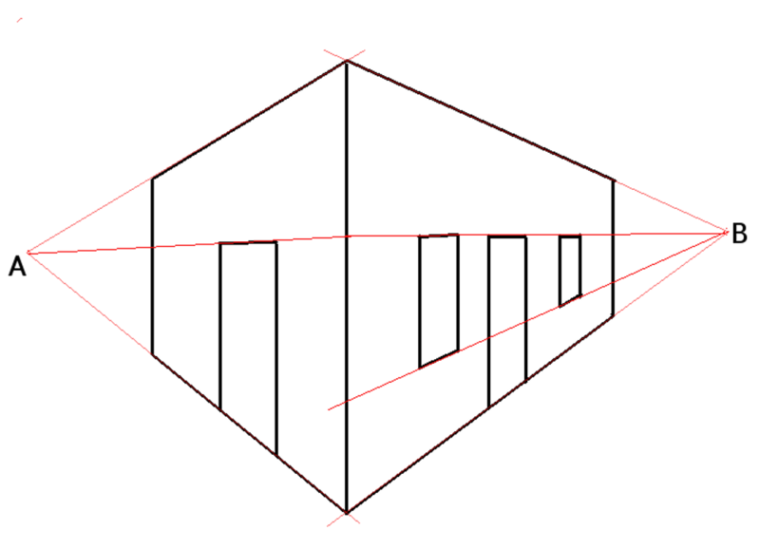
Double point perspective projection

